Slide 1
RUNGTA COLLEGE OF DENTAL SCIENCES & RESEARCH
HYPERSENSITIVITY
DEPARTMENT OF MICROBIOLOGY

Slide 2
Specific learning Objectives
At the end of this presentation the learner is expected to know ;
Core areas* | Domain ** | Category #
Deinition & Introduction | Cognitive | Must know
Types of Reactions | Psychomotor | Must know
Mediators | Cognitive | Desired to know
*Subtopic of importance
** Cognitive, Psychomotor or Affective
# Must know , Nice to know & Desire to know
( Table to be prepared as per the above format )

Slide 3
Table of Content
Definition & Introduction
Classification of Hypersensitivity Reactions
Type 1, 2, 3 & 4 Hypersensitivity Reactions
Mediators of Hypersensitivity Reactions

Slide 4
HYPERSENSITIVITY

Slide 5
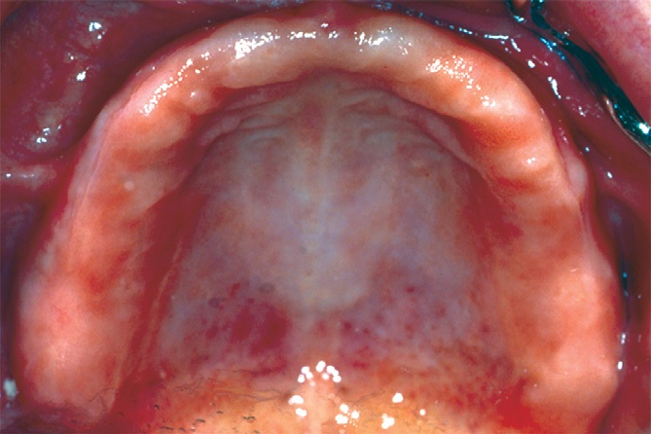
Denture hypersensitivities:

Slide 6
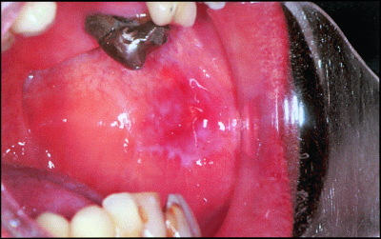
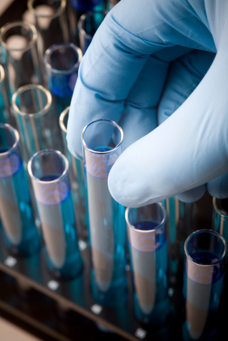
Agents causing hypersensitivity in dentistry;:
-Dentures
-Latex {gloves allergy to doctors also}
-Titanium IMPLANTS and other metals.
-Sulphites (present as preservative
in Local anasthetic agents like
lignocaine).
-local anaesthetic AGENTS.
-dental materials.
-COLD AND HOT allergy
etc.
-Tooth paste, mouth wash and gum paints.

Slide 7
Definition:
Injurious consequences in the sensitized host, following contact with specific antigen is called as hypersensitivity.
When an allergen enters the host it sensitizes the Immune System & leads to priming of B or T lymphocytes – this dose of antigen is called as Sensitizing Dose or Priming Dose.
When again the identical or Immunologically closely related antigen enters the same host, Ag–Ab reaction takes place which results into hypersensitivity - this dose of antigen is called as Shocking Dose.

Slide 8
Definition:
These are cause by activity of immune system detrimental to the host in response to exposure of the antigen to the immune cells of the body.
Can be classified into 4 types:

Slide 9
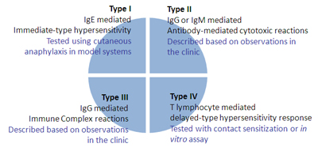
CLASSIFICATION

Slide 10
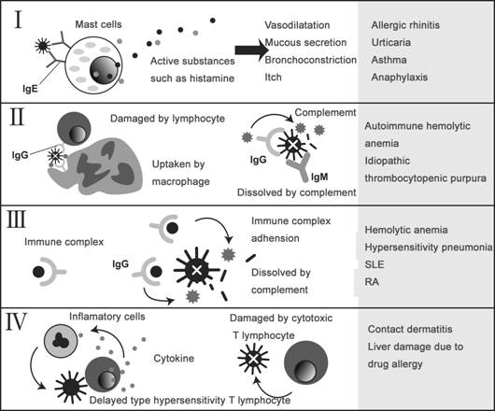
MODE OF ACTION

Slide 11
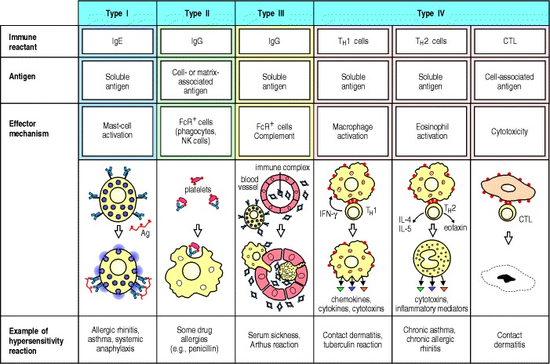

Slide 12
Type-1 hypersensitivity

Slide 13
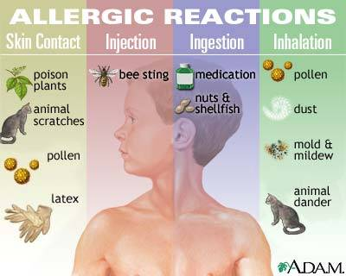
Etiological agents

Slide 14
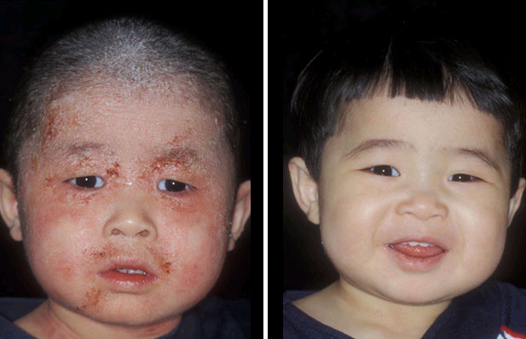
before
after
Atopic dermatitis

Slide 15
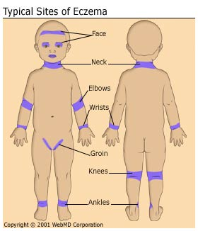

Slide 16
FOOD ALLERGIES

Slide 17
HAY FEVER {SEASONAL ALLERGIC RHINITIS}

Slide 18
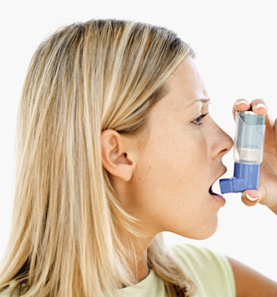
USE
OF
INHALER
FOR
ASTHMA

Slide 19
Type-1 pathogenesis

Slide 20
TYPE I. IMMEDIATE OR ANAPHYLACTIC HYPERSENSITIVITY
- Antibody involved: IgE
- effector cells : tissue mast cells and circulating basophils
- mediators: histamine, Eosinophil Chemotactic Factor (ECF)
- Clinical States: Hay fever, asthma, eczema, anaphylactic shock, helminthic infxn

Slide 21
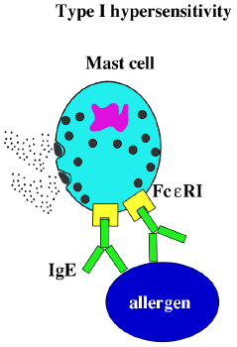

Slide 22
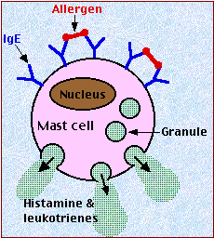

Slide 23
1st contact of Ag with circulating B-lymphocytes with Fab portion of Ab present on surface.
Activation of B-lymphocytes present it to T-cell which differentiate into TH-2 which releases mediators VIZ.. IL-4, IL-5 which causes activation of B-cell into plasma cell.
IgE secretion plasma cell formed by activated B-lymphocytes.
IgE binds to Fc - receptors on mast cells, basophils
[effector cells of type-1 reactions.]

Slide 24
Sensitization of effector cells.
During 2nd contact with same Ag by IgE on effector cells set cell damage.
Membrane lysis, influx of Na+ & water leading to degranulation of mast cell
Pro - inflammatory substance like histamine, leukotrienes, prostaglandin etc leads to inflammation

Slide 25
- increase vascular permeability.
- smooth muscle contraction.
- early vasoconstriction followed by vasodilation.
- increase gastric secretion
- increased nasal &lacrimal secretion.
- increase migration of eiosinophil &basophil to site of local injury.; as wel as eiosinophilia & basophilia.

Slide 26
TYPE 1 HYPERSENSITIVITY ANAPHYLAXIS
This is the CLASSICAL IMMEDIATE HYPERSENSITIVITY REACTION.
A very minute dose, antigens & haptens can sensitise the host & induce anaphylaxis.
There should be interval of 2-3 weeks between Sensitising Dose & Shocking Dose.
The Shocking Dose is effective when given Intravenously, less effective Intraperitoneally, Subcutaneously & least effective Intradermally.

Slide 27
The clinical effects are due to smooth muscle contraction or increased vascular permeability.
Other changes seen are edema, decreased coagulability of blood, fall in blood pressure, temperature, Leucopenia, Thrombocytopenia.

Slide 28
SYMPTOMS & SIGN OF ANAPHYLACTIC SHOCK
Itching of scalp & tongue, Flushing of the skin over the whole body, Difficulty in breathing due to bronchial spasm, Nausea, Vomiting, Abdominal pain, Diarrhoea- sometimes with blood in the stool, Acute hypotension, Loss of consciousness & Death follows.

Slide 29
Human Anaphylaxis is mostly seen following Injections of Antibiotics or other drugs & Insect stings.
Adrenaline 0.5ml of a 1 in 1000 solution –subcutaneously or Intramuscularly – dose repeated up to a total of 2ml over 15 mins.

Slide 30
CUTANEOUS ANAPHYLAXIS
When shocking dose of antigen is given Intradermally to a sensitized host – it develops a Wheal & Flare response( Local anaphylaxis) characterized by pale central area of puffiness due to edema( Wheal) & hyperemia & subsequent Erythema (Flare).
It is useful in testing for hypersensitivity & identifying the allergen.
Skin test may lead to serious even Fatal Reaction so Adrenaline is kept ready.

Slide 31
PASSIVE CUTANEOUS ANAPHYLAXIS
When a small volume of antibiotics are given Intradermally in normal animal, followed by mixture of Antigen & dye (Evan’s blue) given Intravenously after 4-24 hrs – host develops immediate blueing at the site of intradermal injury due to vasodialation & increased capillary permeability- Wheal & Flare Reaction.
It is used to detect human IgG as it is heterotropic & not IgE as it is homotropic.

Slide 32
MECHANISM OF ANAPHYLAXIS
Only Cytotropic IgE participate( IgE bound to surface receptors on Mast cells & Basophils by Fc end) & not circulatory IgE.
When shocking dose of antigen is given, Ag combine with cell bound IgE on mast cells rapidly, the Ag-Ab complex stimulates mast cells & basophils to release mediators resulting in the clinical manifestation of Anaphylaxis.( the Ag – Ab crosslinking increases the permeability of the cells to Ca++ & leads to degranulation , with release of biologically active substances)

Slide 33
PRIMARY MEDIATORS OF ANAPHYLAXIS
HISTAMINE:
It is most important vasoactive amine, formed by decarboxylation of Histidine found in granules of mast cells , basophils & plateletes.
When released in the skin, histamine stimulates sensory nerve producing burning & itching sensations.
It causes vasodialation & hyperemia by an Axon reflex(Flare Effect) & edema by increasing capillary permeability ( Wheal Effect), vasodialation (in organs including Vasculature, Intestine, Uterus & Bronchioles), & smooth muscle contraction.

Slide 34
PRIMARY MEDIATORS contd.
2. SEROTONIN: 5 Hydroxy Trytamine
It is formed by decarboxylation of Tryptophan.
It is found in Intestinal Mucosa , Brain Tissues & Plateletes.
It causes smooth muscle contraction, increased capillary permeability & vaso-constriction.

Slide 35
PRIMARY MEDIATORS contd.
CHEMOTACTIC FACTOR:
They are acidic tetrapeptides released from mast cells granules which are strongly chemotactic for Eosinophil( ECF-A), & contribute to eosinophilia.( a hypersensitivity feature)
NCF-A – attracts neutrophils
4. HEPARIN: It is Acidic Mucopolysaccharide.
5. PROTEASES & HYDROLASES: Enzymatic mediators released from mast cells.

Slide 36
SEC. MEDIATORS OF ANAPHYLAXIS
PROSTAGLANDINS & LEUCOTRIENES :
They are derived from 2 different pathways- the Lipoxygenase pathway leads to formation of leucotrienes, the Cyclo-Oxygenase pathway leads to formation of Prostaglandins & Thromboxane.
They produce slow, sustained contraction of smooth muscle so called as Slow Reacting Substance of Anaphylaxis(SRS-A)
Prostaglandins F2a & Thromboxane A2 are powerful, transient bronchoconstrictors.

Slide 37
SECONDARY MEDIATORS contd.
2.PLATELET ACTIVATING FACTOR ( PAF):
It is low molecular weight lipid released from Basophils which causes aggregation of platelet & release of their vasoactive amine.
3. OTHER MEDIATORS :
Anaphylatoxin released by Complement Activation & Bradykinin & other Kinins formed from Plasma Kininogens.
* ANAPHYLACTOID REACTION : Intravenous injection of peptone, trypsin & other substances provokes anaphylactoid reaction . The clinical resemblance is due to same chemical mediators but it has no immunological basis & is non – specific.

Slide 38
ATOPY ( OUT OF PLACE)
It was introduced by Coca-1923, to naturally occurring familial Hypersensitivity of human typified by Hay fever & Asthma.
The common antigens are –Inhalants- pollen, house dust, Ingestants – egg & milk, some are Contact Allergens to which Skin & Conjuctiva may be exposed, When given Intradermally they induce IgE antibodies.

Slide 39
Atopy sensitisation is developed spontaneously following natural contact with Atopens.
It runs in families ( inheritance is not to a particular antigen but the tendency to produce IgE in large amount)
Atopic Antibodies does not pass through placenta.
It is associated with defeciency of IgA.

Slide 40
ATOPY contd.
The symptoms are produced by release of pharmacologically active substances following combination of Antigen & Cell fixed IgE.
The reaction occurs at the site of entry- Conjuctivitis – Eyes, Rhinitis – Respiratory tract, Gastrointestinal – intestine, Dermatitis – skin, Some times effect may be at remote site- Urticaria – ingestion of Allergen

Slide 41
TYPE-1 AND DENTISTRY
SYMPTOMS ARE HIVES, SWELLING, BURNING, BRONCHOSPASM ,VOMITTING , NAUSEA, DIARROHEA, HYPOTENSION BREATHLESSNESS ETC.
ANAPHYLAXIS IS SEVERE MANIFESTATION OF TYPE 1 AND FATAL TOO.
ALLERGY TO KIWI, TOMATO, CHESTNUT, AVOCADOS, BANANA HAS SOMEWHAT CROSS ALLERGY WITH LATEX TOO.

Slide 42
TYPE II HYPERSENSITIVITY CYTOLYTIC & CYTOTOXIC
They involve combination of IgG ( rarely IgM) with antigenic determinants on the surface of cells & then causes –
Phagocytosis of cell through Opsonic or Immune Adherence.
Cytotoxicity by NK cells.
Lysis through activation of Complement System
Example- Lysis of RBC’S by antierythrocyte antibodies in autoimmune anemias & hemolytic disease of newborn.

Slide 43
TYPE II. CYTOTOXIC HYPERSENSITIVITY
Antibody involved: IgG and IgM
Reactions involved antibodies directed to antigen on surface of specific cells or tissues resulting to cytolysis
Clinical states: rxns to plt. transfusions, Goodpasture’s syndrome, Myasthenia gravis

Slide 44
TYPE -2 HYPERSENSITIVITY

Slide 45
BINDING OF Ag with FAB portion of Ab present on target B-cell (Ag are not solube here rather attach to some APC)
The un-attach Fc fragement of Ab detaches and binds to complement.
Activation of Classical pathway of complement system.
1]C3b causes opsonisation.
2] ADCC
3]Complement mediated inflammation.

Slide 46
EFFECTOR MECHANISM OF TYPE 2
1) OPSONISATION AND FC- receptor mediated phagocytosis:
ag-ab complex -> complement activation -> MAC (membrane attack complex formation) -> opsonisation by C3 & C4 and Fc receptor -> phagocytosis.
In low conc. of ab, complement independent mechanism that is ADCC (Antibody Dependent Cellular Toxicity) occur which is mediated by Neutrophil, Macrophages, NKcells.
2) COMPLEMENT AND Fc MEDIATED INFLAMMATION: When ab gets deposited in blood vessel it causes activation of complement and leads to inflammation at the site of deposition.
3) ANTIBODY MEDIATED CELLULAR DYSFUNCTION: Ab directed against cell surface receptors impair cell’s function without cell injury or inflammation.

Slide 47
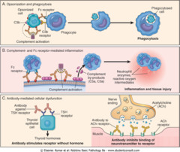

Slide 48
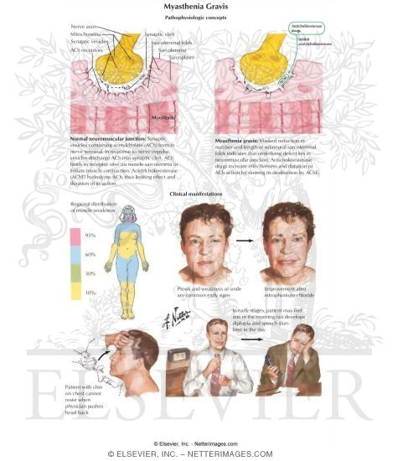
Myaesthenia gravis

Slide 49
TYPE III. IMMUNE COMPLEX HYPERSENSITIVITY
Antibody involved: IgG and IgM
Affects organs where antigen-antibody reactions are deposited
Clinical states: Arthus reaction, Rheumatoid arthritis, SLE, glomerulonephritis, serum sickness

Slide 50
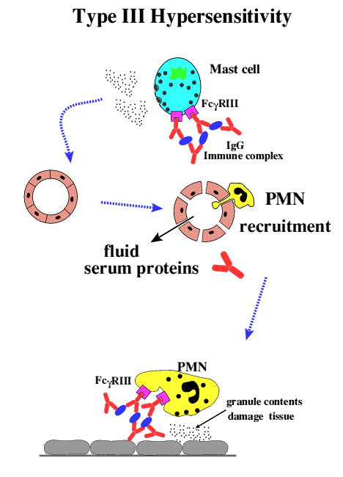

Slide 51
PHASE(1) OR IMMUNE COMPLEX DISEASE CHARCTERISED BY FORMATION OF ANTIBODY ABOUT 5 DAYS AFTER ANTIGEN INVASION.
PHASE (II) OR PHASE OF IMMUNE COMPLEX DEPOSITION: IN GLOMERULI, JOINTS, SKIN, HEART, SEROSA & BLOOD VESSELS.
PHASE III: PHASE OF IMMUNE COMPLEX MEDIATED INFLAMMATION: SEEN IN 10 DAYS AFTER ANTIGEN INGESTION, LEADING TO GLOMERULONEPHRITIS, VASCULITIS, ARTHRITIS.

Slide 52
IMMUNE COMPLEX ALSO CAUSES :
(A) ACTIVATION OF COMPLEMENT CASCADES RESULITNG IN NEUTROPHILLIC INFILTRATION., VASODILATION, EDEMA.
(B) ACTIVATION OF COAGULATION CASCADE AND MICROTHROMBI FORMATION.
(C ) BLOOD VESSELS SHOWS PRESENCE OF FIBRINOID NECROSIS & NECROTISING VASCULITIS.

Slide 53
TYPE III HYPERSENSITIVITY IMMUNE COMPLEX DISEASE
1.ARTHUS REACTION: It is local manifestation of generalized hypersensitivity.
In this tissue damage occurs due to formation of Ag-Ab ppt causing complement activation & release of inflammatory molecules, this leads to increased vascular permeability & infiltration of the site by neutrophils.

Slide 54
Leucocyte – Platelet thrombi are formed that reduce blood supply & lead to tissue necrosis.
The Arthus reaction can be passively transferred with sera containing precipitating antibodies (IgG , IgM) in high titre.

Slide 55
TYPE III Hs contd.
2. SERUM SICKNESS : This is systemic form of Type III Hs.
It appears after 7 – 12 days following single injection of high conc. of foreign serum such as Diptheria antitoxin.
The clinical syndrome consists of fever, Lymphadenopathy, Splenomegaly, Arthritis, Endocarditis, Vasculitis, Glomerulonephritis,, Urticarial Rashes, Abdominal Pain, Nausea & Vomiting.

Slide 56
TYPE III Hs contd.
The pathogenesis is due to deposition of Immune Complex on the endothelial lining of blood vessel in various parts of body, causing inflammatory infiltration.
The plasma level falls due massive complement activation & fixation by Ag-Ab complexes.
In Serum Sickness single injection serve both as sensitising & shocking dose

Slide 57
TYPE IV. CELL-MEDIATED/DELAYED-TYPED HYPERSENSITIVITY
Reaction involves sensitized T cells and release of its lymphokines as mediators and amplifiers
Mediated by cells rather than antibodies
Clinical states: Contact dermatitis, GVHD
reactions, Transplant rejection, PPD (Tuberculin Test for MTB)

Slide 58
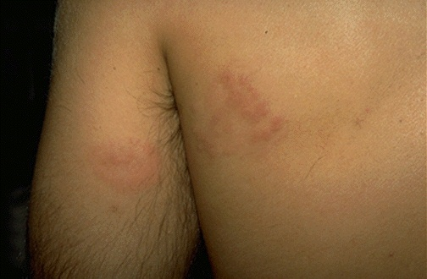
This is contact dermatitis, a form of type IV hypersensitivity in which pre-sensitized lymphocytes led to this inflammatory reaction a couple of days after contact with the offending plant material. Antigens such as those in poison oak and poison ivy are most often responsible for this appearance.

Slide 59
Type-4 hypersensitivity
Entry of Ag, recognized by CD+8, basophil,
mast cell and processed by APC
Migrate to lymph node, presents Ag to helper T-cell [CD+4]
T-cell differentiate into TH-1
SENSITIZE TH-1 remain in MEMORY pool.
On re-exposure of same Ag.
release of cytokines like substances

Slide 60
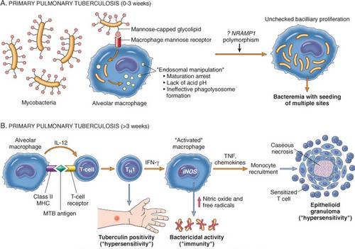

Slide 61
TNF- alfa extravasation of lymphocytes, monocytes.
IFN-Y activation of macrophages.
IL-1,2 produce by macrophage and dendritic cell critical in pathogenesis as induces TH-1
IL-2 causes proliferation of ag spc T-cells
Above events leads to granuloma-formation.
Effect prolonged & may last for 14 days.
Ex: T.B., leprosy, virally infected cell, malignant cell, organ- transplantaion, garft-versus host reaction.

Slide 62
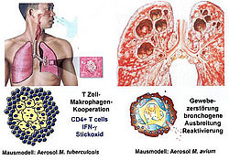

Slide 63
TYPE IV HYPERSENSITIVITY DELAYED HYPERSENSITIVITY
They are provoked by Intracellular microbial infection or haptens, when applied on skin evolve slowly & consists of mixed cellular reaction involving Lymphocyte & Macrophages.
The sensitised Lymphocytes on contact with specific Antigens, release Lymphokines that cause biological effect on Leucocytes, Macrophages & tissue cells.

Slide 64
It cannot be passively transferred by serum but by Lymphocytes or the transfer Factor.
Two Types Of Delayed Hypersensitivity :
TUBERCULIN TYPE
CONTACT DERMATITIS TYPE

Slide 65
TYPE IV Hs - Delayed Hs contd.
1.TUBERCULIN TYPE :
When a small dose of Tuberculin is injected Intradermally in an individual sensitised to Tuberculoprotein by prior infection or immunisation, an indurated inflammatory reaction develops at the site within 48-72 hrs.
In unsensitised it provokes no response.
Seen with many infections like Bacteria, Virus, Fungi, Parasite(with sub-acute or chronic infection & intracellular pathogen)

Slide 66
Delayed Hypersensitivity contd.
2. CUTANEOUS BASOPHIL TYPE :
A local reaction resembling Tuberculin is produced by Intradermal injection of some antigens.
It can be passively transferred by serum.
*CONTACT DERMATITIS TYPE :
Delayed hypersensitivity sometimes result from skin contact with metals such as Nickle, Chromium, Picryl chloride, Dinitrochlorobenzene, Penicillin, Toileteries.

Slide 67
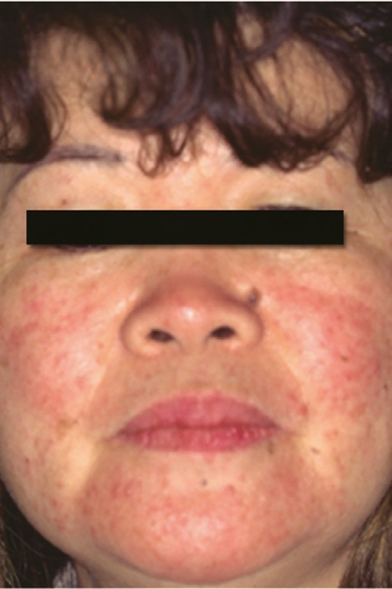
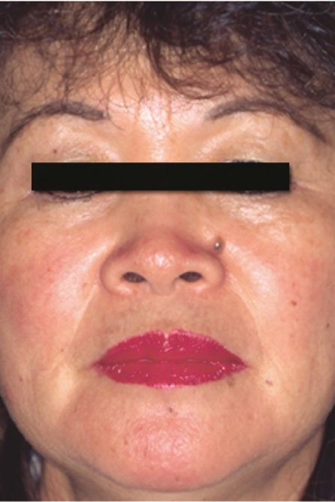
IMPLANT INDUCED TYPE-4 REACTION
10 DAYS AFTER IMPLANT REMOVAL

Slide 68
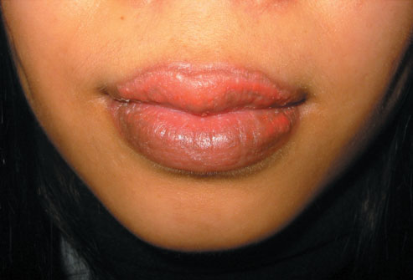

Slide 69
TYPE-4 AND DENTISTRY
ASSOCIATED MAINLY WITH PROSCESSED NATURAL RUBBER i.e; latex
Symptoms usually takes hours and days
After exposure and consist of scabbing, soreness, itching, Redness, vesicles,
Cessation of symptoms occur in weeks after removal Of offending allergens.
NOTE: IT DOES NOT INVOLVES Ab.

Slide 70
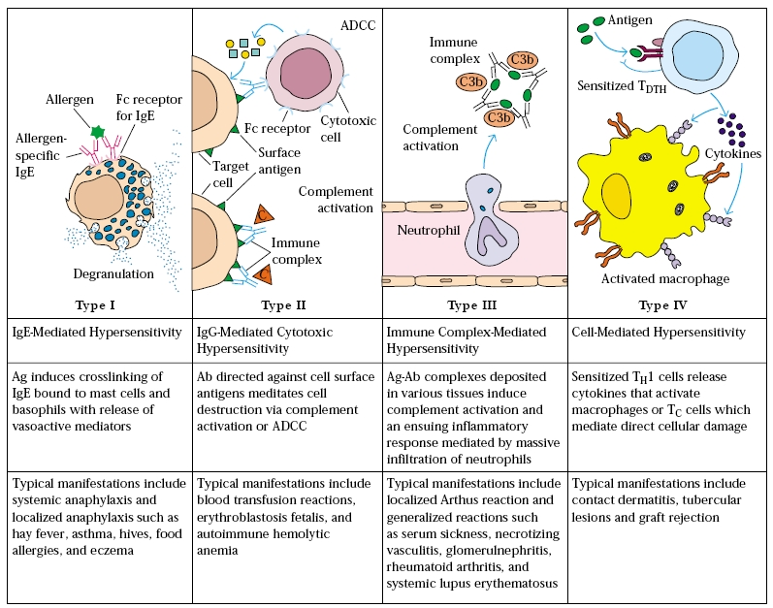

Slide 71
TYPE | DESCRIPTIVE | INITIATION | MECHANISM | EXAMPLES
 | NAME | TIME
I | IgE-mediated hypersensitivity | 2-30 mins | Ag induces cross-linking of IgE bound to mast cells with release of vasoactive mediators | Systemic anaphylaxis, Local anaphylaxis, Hay fever, Asthma, Eczema
II | Antibody-mediated cytotoxic hypersensitivity | 5-8hrs | Ab directed against cell-surface antigens mediates cell destruction via ADCC or complement | Blood transfusion reactions, Haemolytic disease of the newborn, Autoimmune Haemolytic anaemia
III | Immune-complex mediated hypersensitivity | 2-8hrs | Ag-Ab complexes deposited at various sites induces mast cell degranulation via FcgammaRIII, PMN degranulation damages tissue | Arthus reaction (Localised); Systemic reactions disseminated rash, arthritis, glomerulonephritis
IV | cell-mediated hypersensitivity | 24-72hrs | Memory TH1 cells release cytokines that recruit and activate macrophages | Contact dermatitis, Tubercular lesions

Slide 72
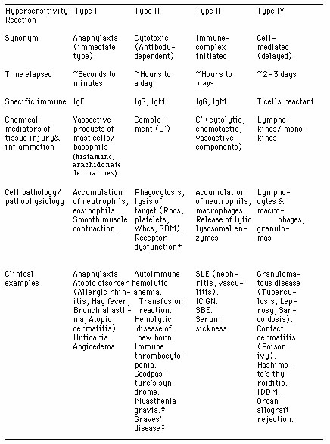
CONCLUSION

Slide 73
TAKE HOME MESSEGE/ FOR THE TOPIC COVERED (SUMMARY)
At the end of this Topic students must be equipped about Hypersensitivity Reactions and its consequences

Slide 74
REFERENCES
Microbiology – Prescott, et al.
Microbiology – Bernard D. Davis, et al.
Clinical & Pathogenic Microbiology – Barbara J Howard, et al.
Immunology an Introduction – Tizard.
Immunology 3rd edition – Evan Roitt, et al.
Medical Microbiology – Greenwood
Textbook of Microbiology – Ananthnarayan
The short Text Book of Microbiology – Satish Gupte

Slide 75
Question & Answer Session
Students should be given opportunity to ask question for clarifying for their understand/ confusions. Teachers must spend 5-10 minutes for this to improve the output.

Slide 76
THANK YOU

